Slide 1


EnDeQ ( The encryption-Decription)
1
SUBMITTED TO
SUBMITTED BY
Mr. Vijay Bijlwan sir | Rohit Kumar | 19134501029
B. Tech(CSE) - 6th Sem.
Session(2019-2023 )
Department of Computer Science & Engineering School of Engineering and Technology
H.N.B.Garhwal University, Srinagar(Garhwal), Uttarakhand

Slide 2
CONTENTS
2
Introduction – EnDeQ
Home Screen
Caesar cipher
Connect with me
Playfair cipher
Flow Diagram
Conclusion
References

Slide 3
EnDeQ(Encyption-decryption of Data messages)
3
INTRODUCTION
As The name specified “EnDeQ” , It is a web Application developed for Encrypting and decrypting the data or massage or information.
This particular project deals with the problems of accessing by third person when sender send message to receiver.
EnDeQ is based on the concept to generate the cipher text (encrypted message) from plain text and plain text(decrypted text message) from cipher text.
User and receiver user a key to encrypt and decrypt the messages.
The whole project is designed in HTML, CSS,and Javascript language and CSS is used for designing the web page and Javascript Used for doing coding of encryption & decryption..and
I have deployed this project on github and the github link is below :
Github Web link : https://rohitkr01.github.io/EnDeQ/

Slide 4
Home Screen
Home screen contain
Caesar cipher page .
button of redirecting to playfair cipher
Playfair cipher

Slide 5
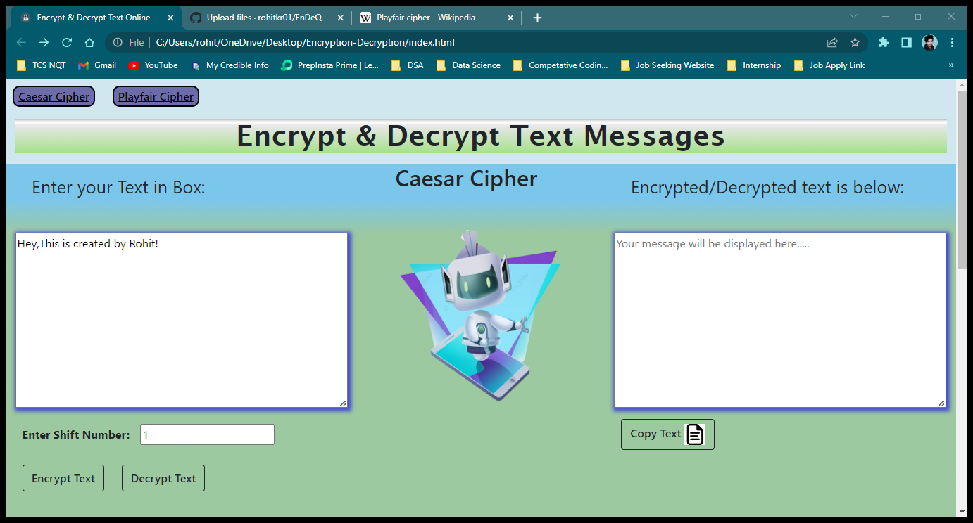
Web Page
4
Caesar cipher….
Enter plain text in left input box
Select shift Number
Tap on the Encrypt text button
You will see the encrypted text message in right side box

Slide 6
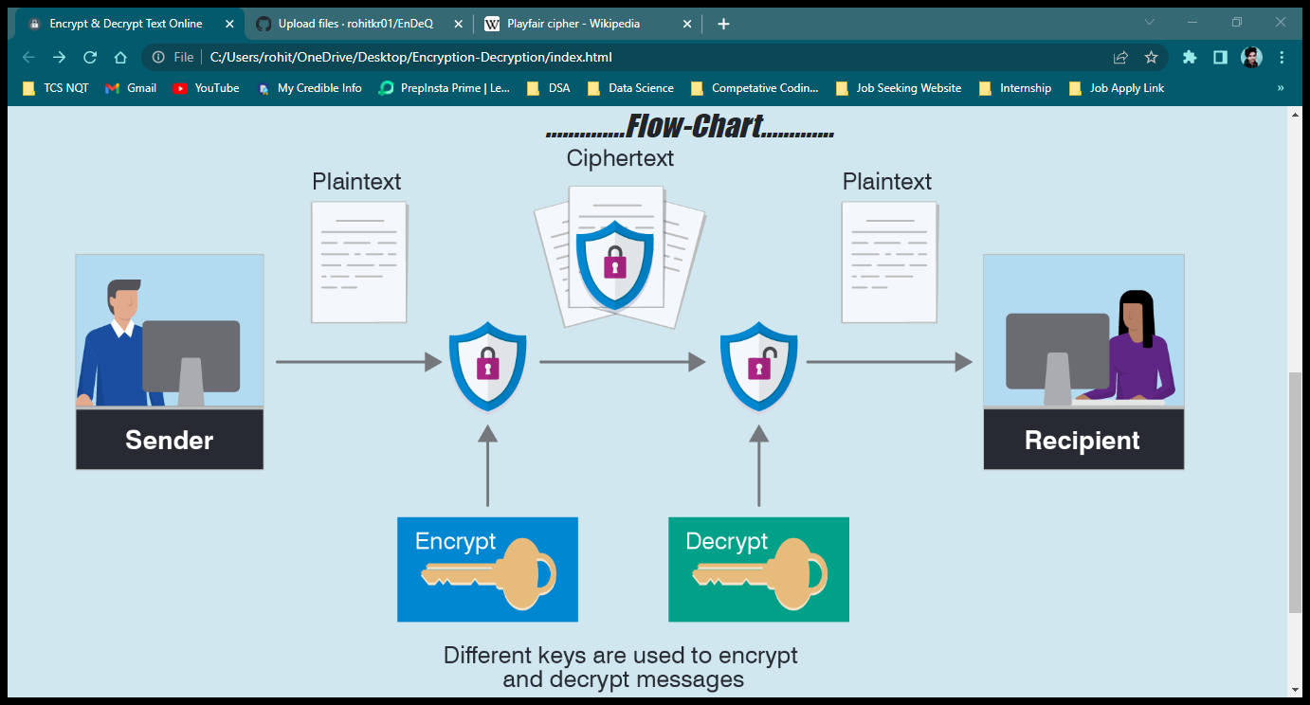
Flow-Chart
5
Sender send message (Plain text)
A key is Used to Encrypt and decrypt the message .
Encryption key encrypt the plain text to cipher text .
Decryption key decrypt the cipher text into plain text(Original text).
Receiver receive the message after decrypting the cipher text into plain text.

Slide 7
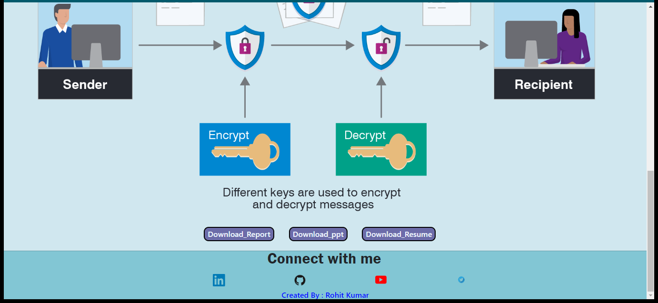
Connect with me :

Slide 8
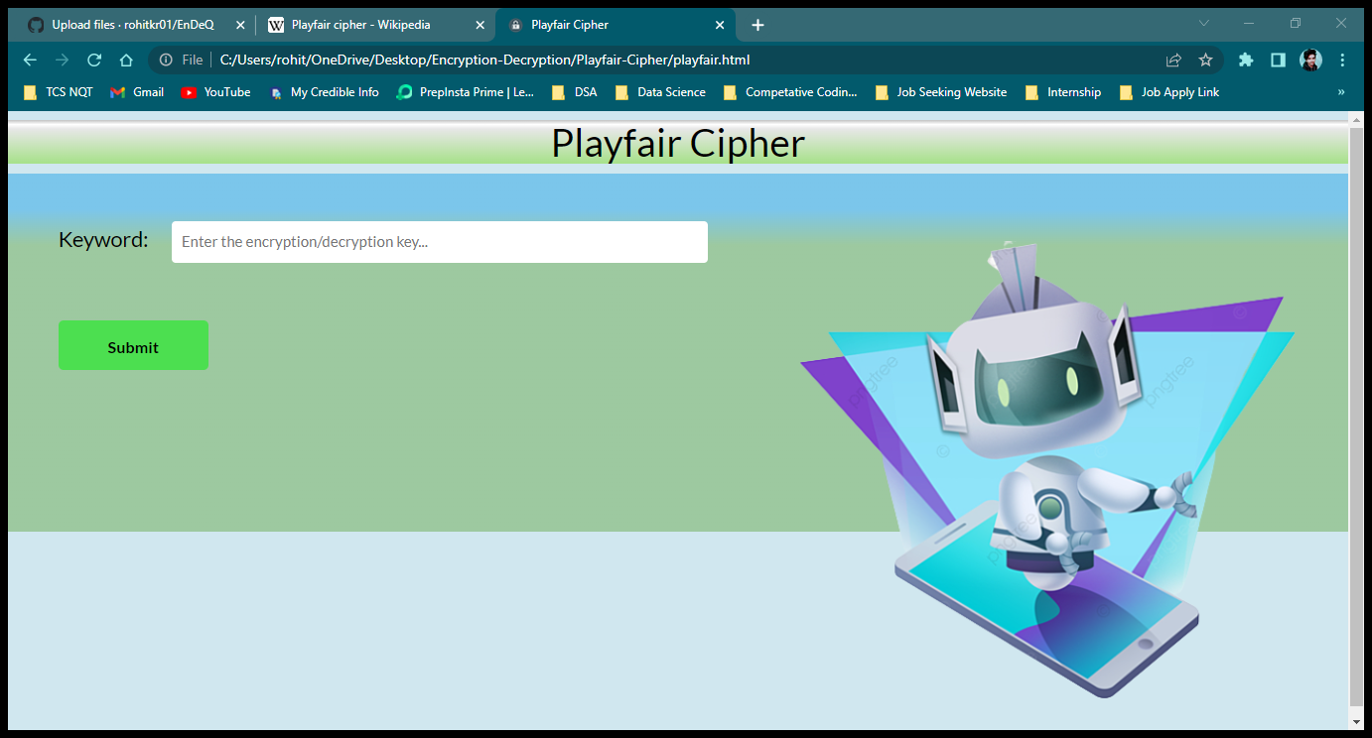
PlayFair Cipher
7
Enter the key
Tap on Submit

Slide 9
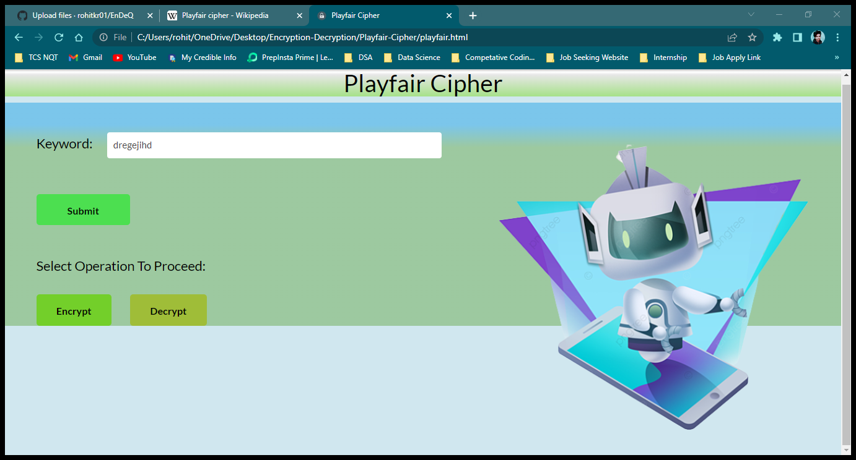
PlayFair Cipher
7
After tappng on the submit button
Tap on the encrypt button

Slide 10
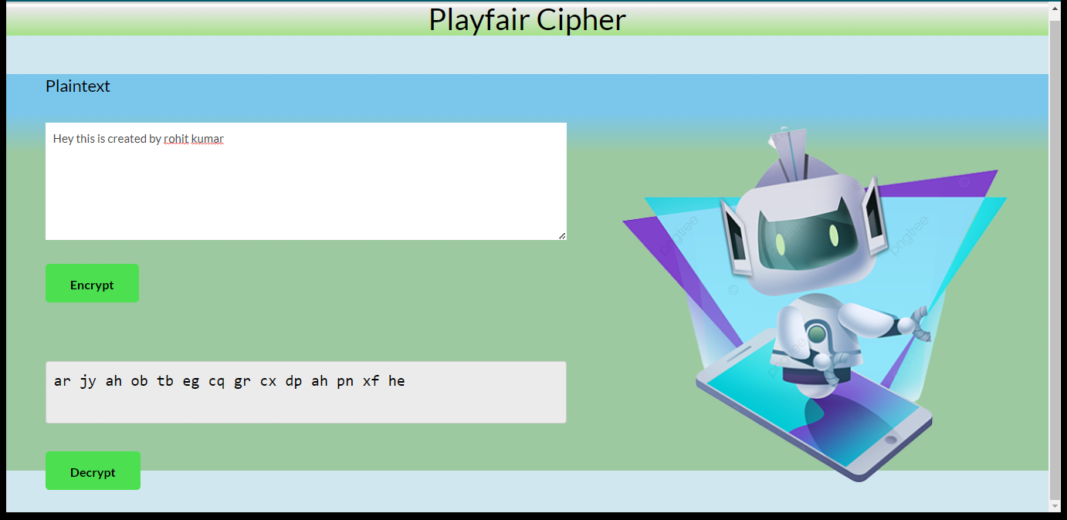
PlayFair Cipher
7
Enter the plain text in above input box
Tap on Cncrypt button
You will see the encrypted message in bellow box
Tap on decrypt button to decrypt the message

Slide 11
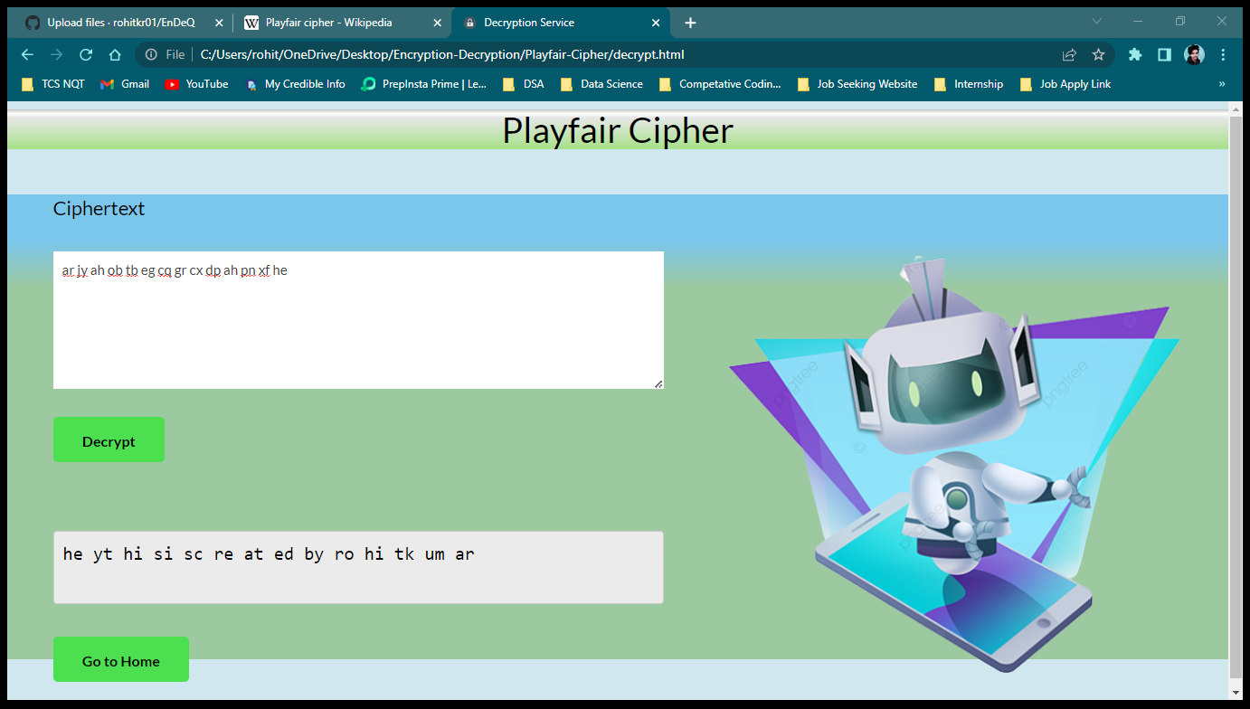
PlayFair Cipher
7
Enter the cipher text in above input box
Tap on decrypt button
You will see the plain message in bellow box
Tap go to home button to redirect home of playfair cipher page.

Slide 12
Flow diagram(Whole Process)
10
9
Home/Caesar cipher
H
Enter plain text
Select shift Number
Encrypt
Playfair Cipher
1
1
Enter Key
2
Cipher text
2
3
Flow Chart
3
Enter cipher text
Enter plain text
5
Key
Plain text
Key
Cipher Text
Plain text
4

Slide 13
Conclusion
14
We can secure you messages.
As we toward a society where automated information resources are increased and cryptography will continue to increase in importance as a security mechanism.
Electronic networks for banking, shopping, inventory control, benefit and service delivery, information storage and retrieval, distributed processing, and government applications will need improved methods for access control and data security.
The information security can be easily achieved by using Cryptography technique
Encryption with two keys instead of one key already will increase the efficiency of cryptography..

Slide 14
References
15
https://www.geeksforgeeks.org/caesar-cipher-in-cryptography/
https://www.umsl.edu/~siegelj/information_theory/projects/des.netau.net/conclusion.html
https://en.wikipedia.org/wiki/Playfair_cipher

